Slide 1
Towards Automatic Multilingual Readability Assessment
Thesis Proposal – April 2016 – Boise State University
Ion Madrazo Azpiazu
Advisor: Dr. Sole Pera

Slide 2



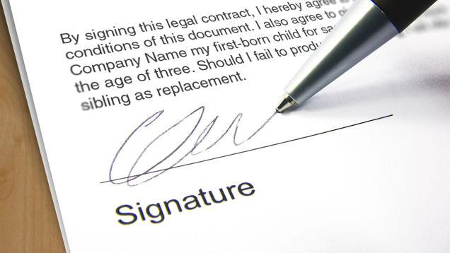
Motivation
Reading for learning versus reading for understanding
Notes:
Reading: important skill
Curricula
Real life
75% comprehension
Perfect balance
Positive
Learning
Reading for understanding
Cases
Medical
Frustation and better results in medical
Most still complex
Share common issue
Stakeholder needts to determine is text is adequate

Slide 3


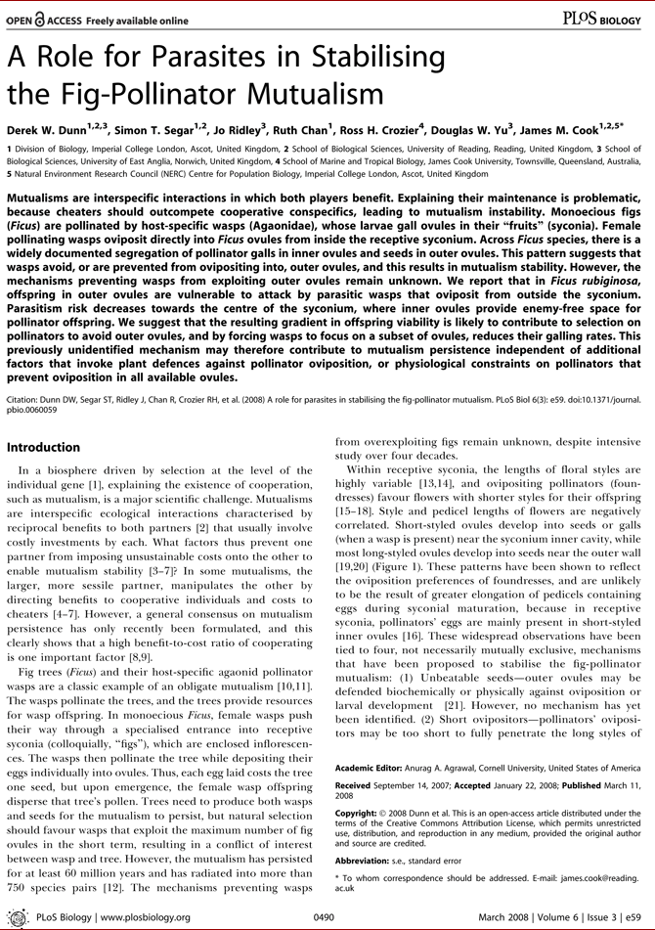
What is Readability?
Text complexity/Readability
Notes:
Readability is aimed at helping stakeholders in previous situation.
Refers to the ease of which a text can be read
Example
Histo

Slide 4




Applications of Readability
Text simplification for people with reading difficulties
Book recommendation
Literacy assessment
Ensuring medical and legal document understanding

Slide 5
Related Work
Tool | Language | Features | Material type
Flesh, FOG… | Multilingual | Shallow | Long text snippets
Lexile and AR | English | Shallow | Books
Troll | English | Shallow, metadata… | Books
Errexail | Basque | Syntax, Morphology | Long text snippets
ChineseRA | Chinese | Lexical | Long text snippets
Read-it | Italian | Syntax | Sentences
LegalRA | English | Metadata, Syntax | Legal documents
FrancoisRA | French | Syntax, Semantics | Long text snippets
Notes:
Readability area is extense
It started in the 40’s
Multilingual before
Not now
Variety regarding features and materials
Explain each system

Slide 6
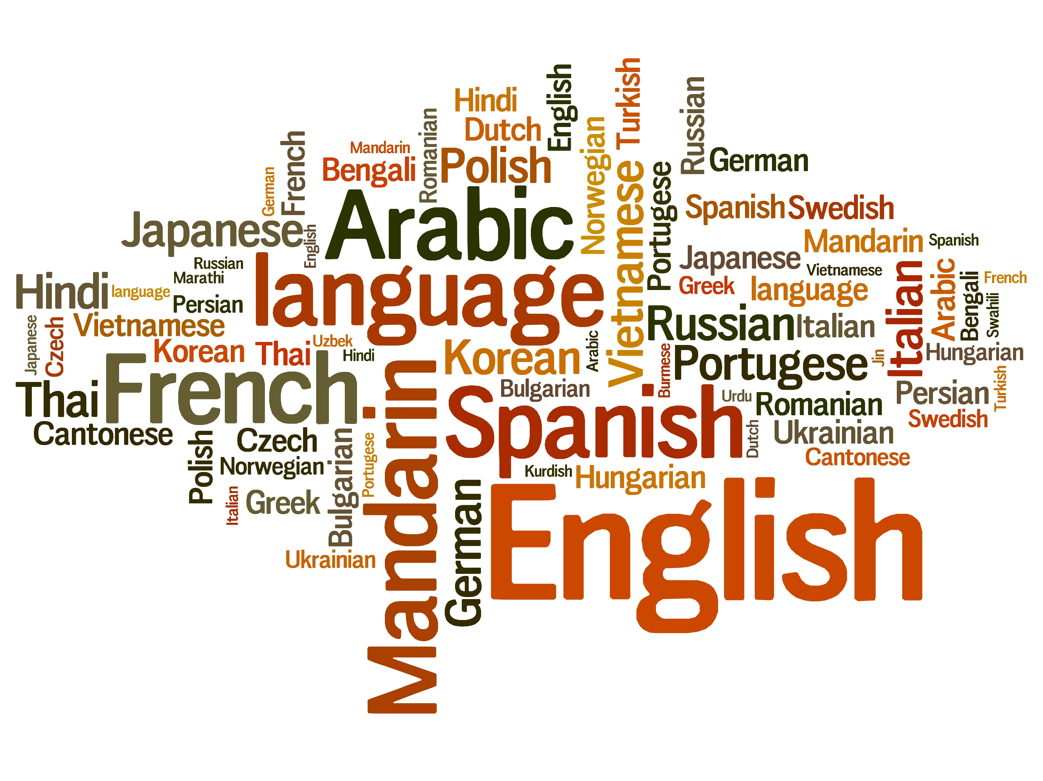
Related Work: Languages
Notes:
Readability area is extense
It started in the 40’s
Multilingual before
Not now
Variety regarding features and materials
Explain each system

Slide 7
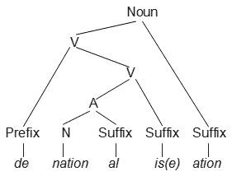

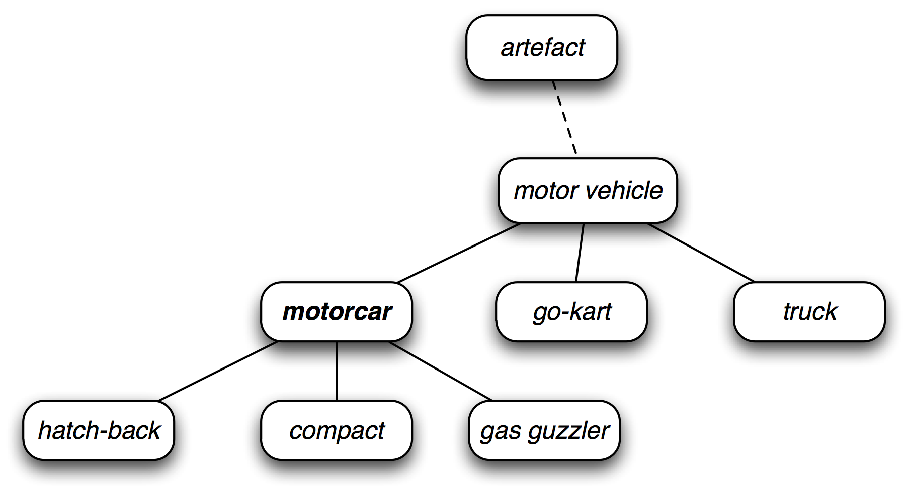
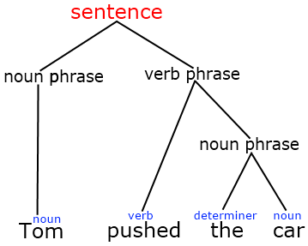
Related Work: Features
Morphologic:
Metadata:
<category/>
Traditional:
Syntactic:
Syntactic:
Semantic:

Slide 8


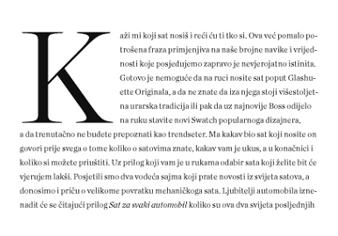
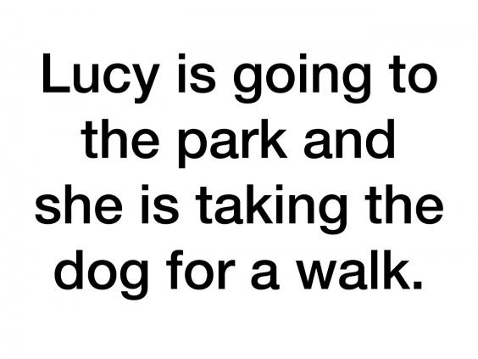

Related Work: Document Types

Slide 9
Thesis Statement
Multilingual Readability Assessment System (MRAS)
Multilingual
Multi-document
Open-source
Adaptable
How:
Analysis of existing features
Exploration and design of new features
Analysis of fusion methods

Slide 10
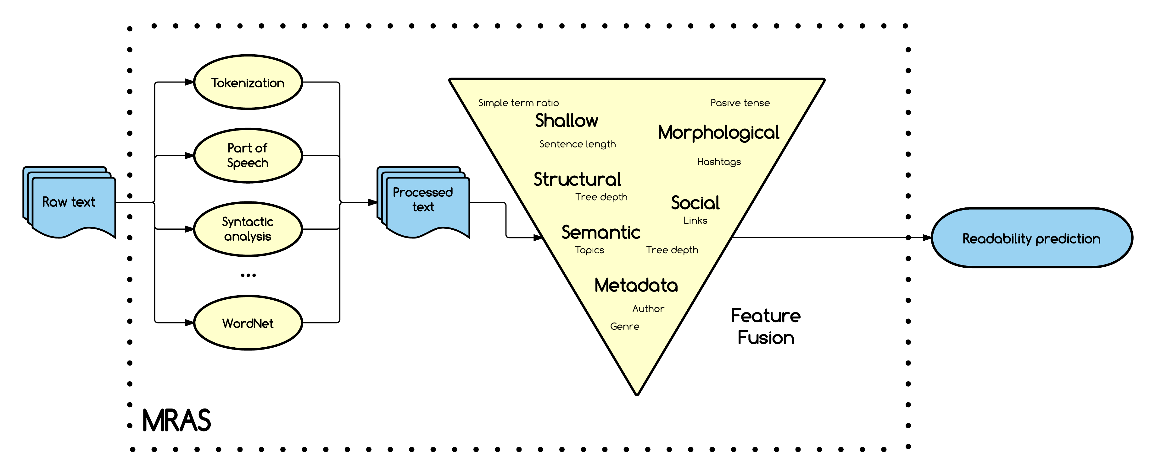
Proposed Method

Slide 11
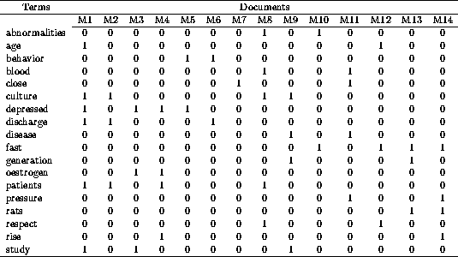
Text Processing
Tokenization
Sentence Split
Part of Speech
Dependency
Named entities
WordNet
Freeling
LSA

Slide 12
Feature Extraction
Shallow features
Morphological
Structural
Word length
Sentence length
Semantic
Social*
Metadata
Syntactic
Pragmatic
Concept density
Followability*
Hashtags
Links
Mentions
Author
Description
Genre
Tense
Number
Dependency ngrams *
Ambiguity*
*Novel

Slide 13
Feature Fusion
Classification
Regression
Ordinal Classification

Slide 14
Evaluation
Dataset
Metrics: Accuracy, Precision, Recall, RMSE…
Language | Dataset | Description
English | Lexile | Contains book titles associated with readability level
 | Standardized tests | Tests for English level, contain various texts per test
 | Other | News for kids, exercises for learning English
Spanish | Lexile | Contains book titles associated with readability level
 | Learning resources | Various exercises for learning Spanish
Basque | Learning resources | Various exercises for learning Basque
Multilingual | Parallel corpus | Same documents translated into English and Spanish

Slide 15
Research Questions
Performance: Learning model, Feature subset
Features versus Language
Comparison : Baselines, State of the art
Same text in different language, same readability level?
Can a MRAS be trained for two languages and predict a third one?
Languages with low resources, can get help of other languages’s data?

Slide 16
Schedule
Date | Milestone
April 2016 | Gather existing datasets for design and development
May 2016 | Feature Exploration
June 2016 | Feature fusion
July 2016 | Experiments
July 2016 | Thesis draft
August 2016 | Defense

Slide 17
Questions?

